Slide 1
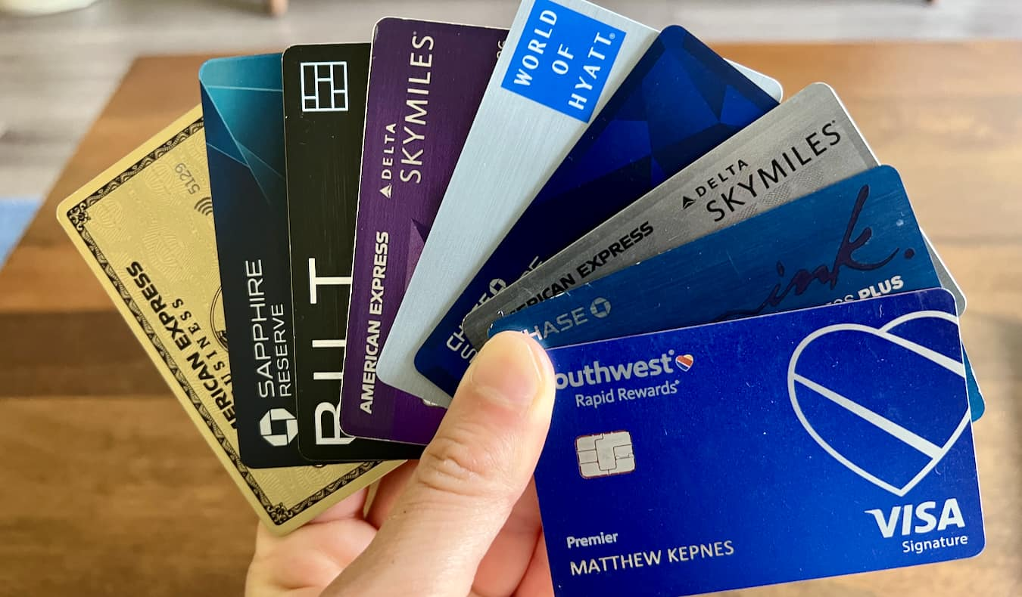



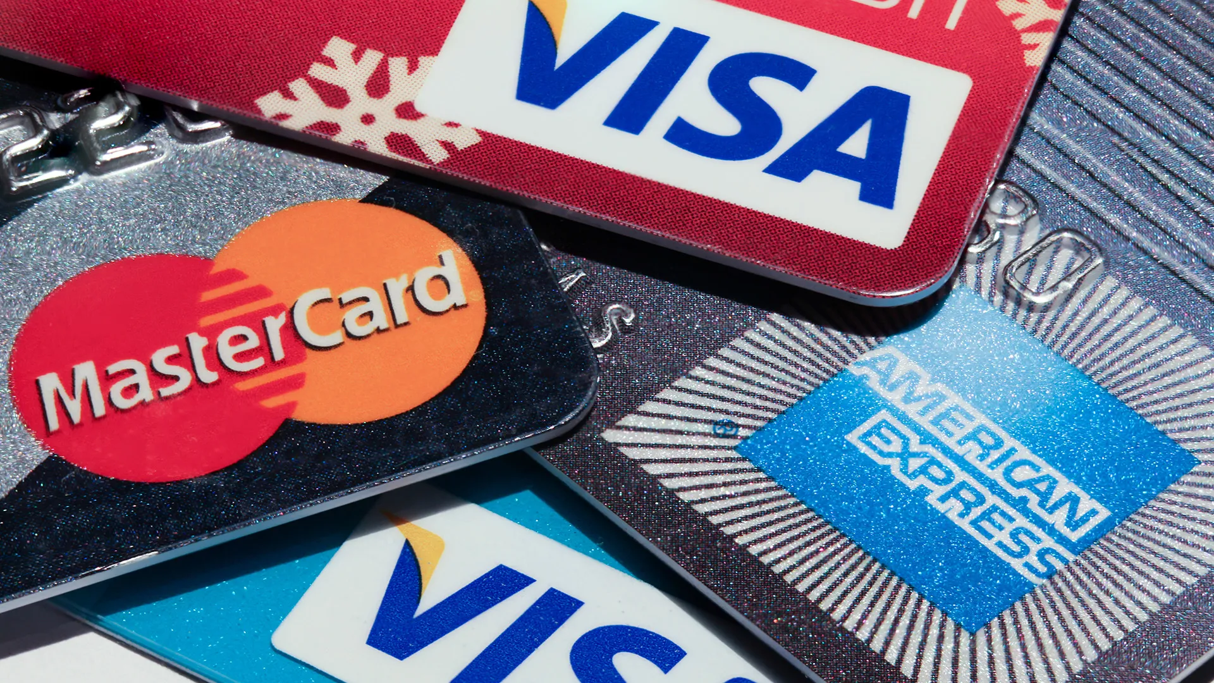
Data Mining Term Project
Credit Card
Fraud Detection
Contributors:
Niketan Baranwal, Keyu Chen, Debasis Tripathy, & Mark Grober
Notes:
Everyone

Slide 2
The Problem
In today’s increasingly digital world, credit cards have become an indispensable tool for everyday transactions. Credit cards help facilitate seamless transactions while driving economic activity, but they also come with a significant risk: credit card fraud.
Credit card fraud encompasses a wide range of illegal activities, one of the main ones being unauthorized purchases using stolen card details. This poses a substantial risk to individuals who use credit cards and financial institutions that provide these credit card services to consumers.
Notes:
Niketan

Slide 3
Why fix the problem?
There are many important reasons to detect and prevent credit card fraud:
We can avert significant financial losses for the consumers and institutions partaking in these transactions.
Robust systems for detecting and mitigating fraudulent transactions are crucial for financial institutions to cultivate and maintain consumer trust. When users feel confident in the security of their transactions, they are more likely to embrace credit cards and adopt digital payment systems.
Financial institutions that are known to have weak fraud detection systems can suffer significant reputational damage.
Notes:
Niketan

Slide 4

Our Solution
Creating robust systems for detecting and mitigating fraudulent transactions so we can cultivate and maintain consumer trust.
Avert significant financial losses for the consumers and institutions partaking in these transactions.
Institutions that have weak fraud detection systems can suffer significant reputational damage, we want to ensure that this is not the case.
Notes:
Niketan

Slide 5




Data Source
The dataset contains transactions made by credit cards in September 2013 by European cardholders.
This dataset presents transactions that occurred in two days. It contains only numerical input variables resulting from a PCA transformation.
Unfortunately, due to confidentiality issues, the original features and more background information about the data are not provided.
The dataset has been collected and analysed during a research collaboration of Worldline and the Machine Learning Group (http://mlg.ulb.ac.be) of ULB (Université Libre de Bruxelles) on big data mining and fraud detection.
Notes:
Niketan

Slide 6
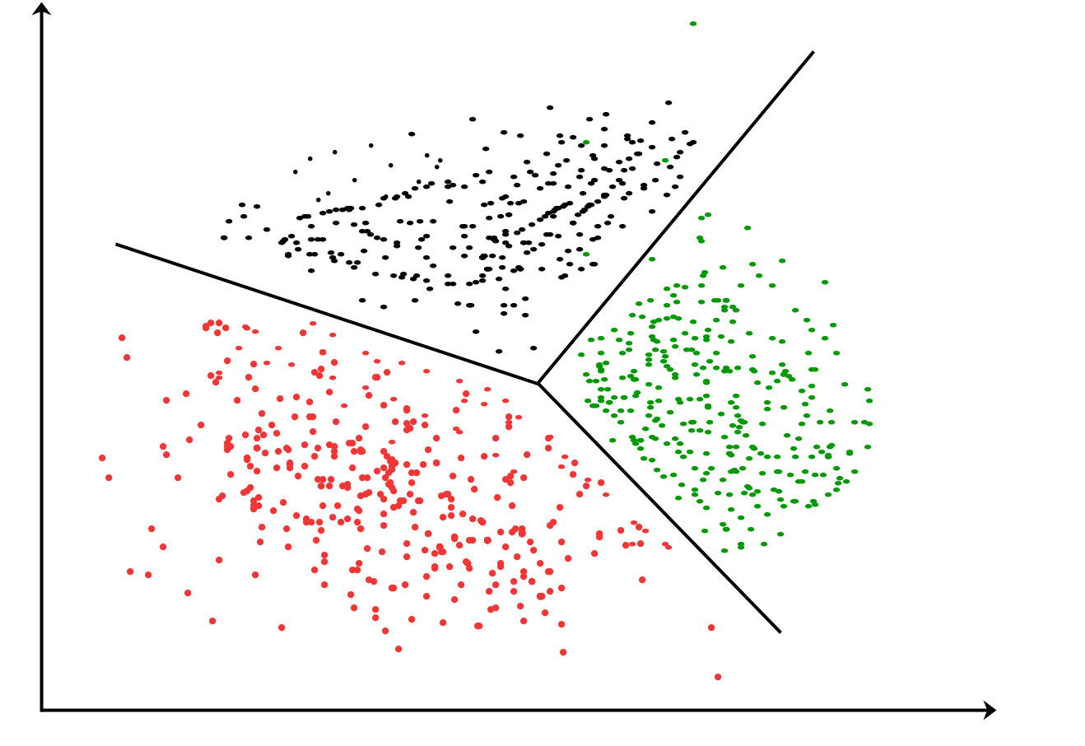
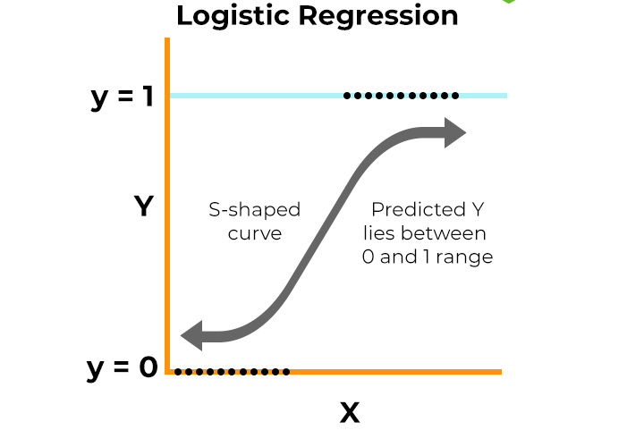
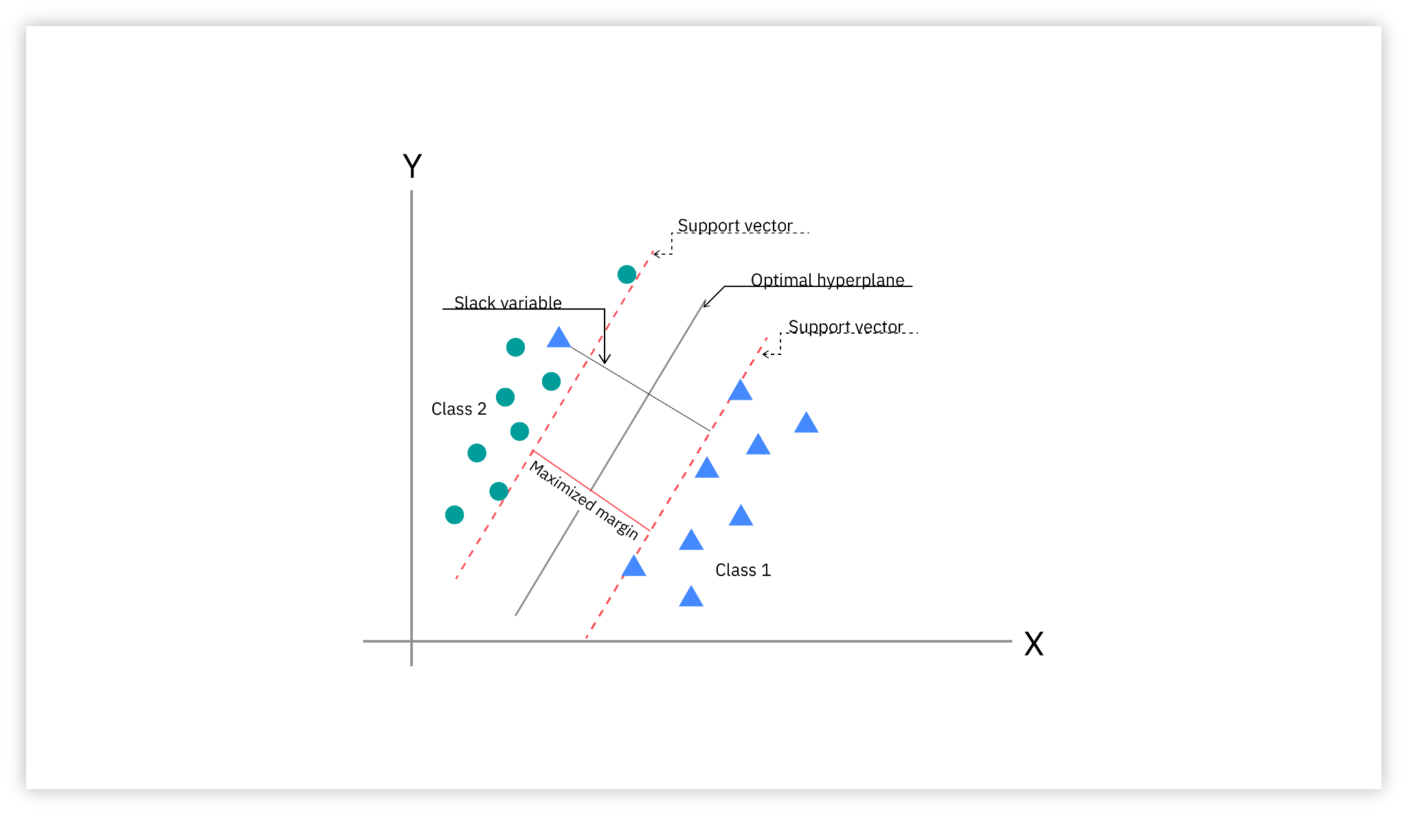
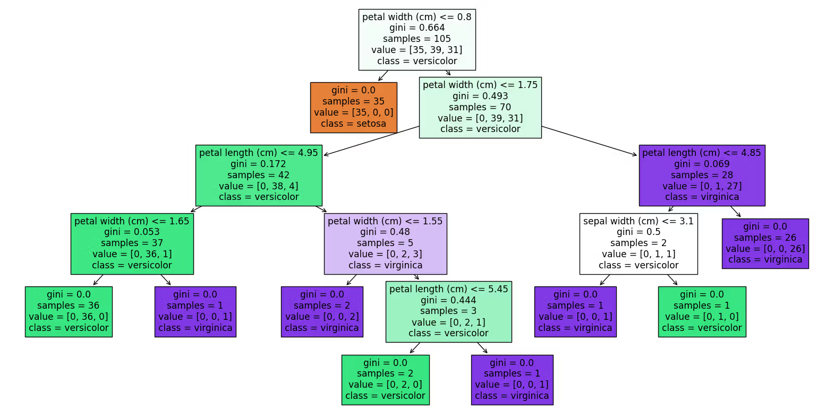
Classification Models
We explore different ways of classifying fraudulent credit card transactions using the following techniques :
Support Vector Machine (SVM) - Niketan Baranwal
Tree-Based Models - Niketan Baranwal
Logistic Regression - Keyu (Kevin) Chen
K Nearest Neighbor (KNN) - Mark Grober
Hybrid Classification Model - Debasis Tripathy
Notes:
Niketan

Slide 7
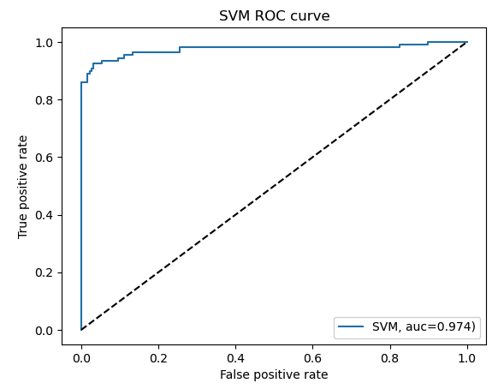
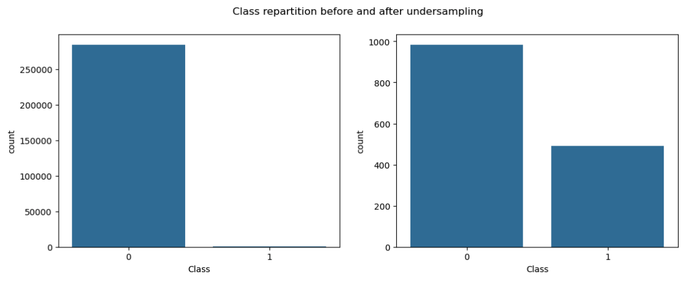
Support Vector Machine
Accuracy: 0.9493 (or 94.93%)
Precision: 1.0 (or 100%)
Recall: 0.8611 (or 86.11%)
F1 Score: 0.9254 (or 92.54%)
AUC Score: 0.9742 (or 97.42%)
In the context of credit card fraud detection, SVMs are trained on historical transaction data labeled as either "fraudulent" or "legitimate."
Once trained, the SVM model can predict which new and unseen transactions are likely to be fraudulent.
Notes:
Niketan

Slide 8
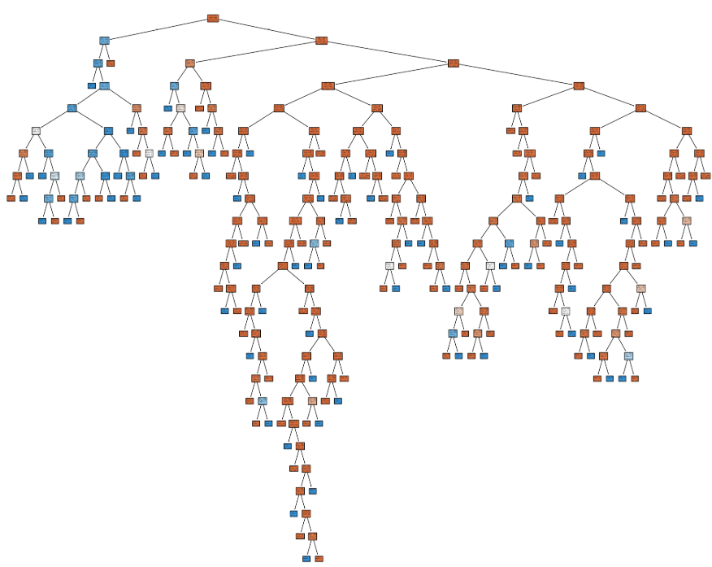
Tree-Based Models
For the tree-based models, we decided to instantiate 2 separate trees - the first is an unweighted tree, while the second is a tree with balanced class weights.
Accuracy: Both the unweighted and weighted trees have very high accuracy (around 99.91-99.92%)
Precision: The unweighted tree had slightly better precision (0.7113) compared to the weighted tree (0.6939).
Recall: The unweighted tree also had slightly better recall (0.7841) compared to the weighted tree (0.7727).
F1-Score: The unweighted tree had a slightly higher F1-score (0.7459) compared to the weighted tree (0.7312)
AUC: The unweighted tree had a slightly higher AUC (0.8918) compared to the weighted tree (0.8861)
While the goal of class weighting is usually to improve performance on the minority (fraudulent transactions) class, it didn't have that effect here, instead, it seems to slightly worsen the model's ability to correctly classify both fraudulent and non-fraudulent transactions.
Notes:
Niketan

Slide 9
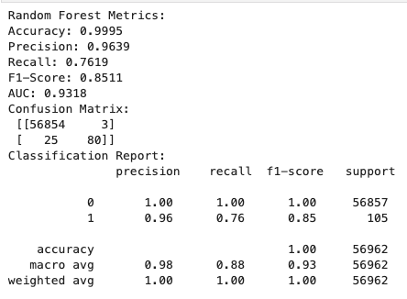
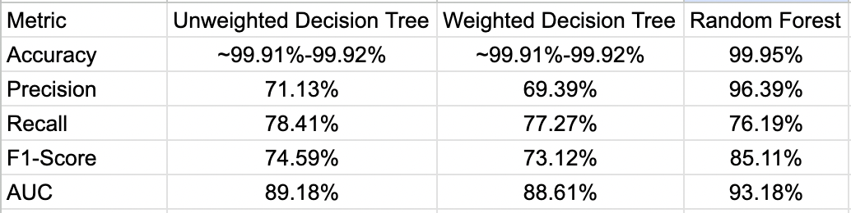
Addressing the Limitations of Decision Trees with Random Forests
While class weighting helps our Decision Tree pay more attention to the minority (fraudulent transactions) class during training, it doesn't fundamentally address the issues of high variance and overfitting that are a part of single deep trees.
A Random Forest leverages the power of ensemble learning to reduce overfitting, improve robustness, and better capture complex relationships.
The Random Forest model would likely provide a more reliable and higher-performing model for credit card fraud detection tasks compared to the single Decision Tree model we used for this project, even one with balanced class weights.
A Random Forest model would give us a better balance between precision and recall and a higher overall ability to separate fraudulent and non-fraudulent transactions.
Notes:
Niketan

Slide 10
Logistic Regression
Goal: Build an effective, streamlined credit card fraud detection model using logistic regression.
Approach Highlights:
Used only pandas and scikit-learn (no numpy or extra libraries).
Steps：Data loading → Class balancing → Train/test split → Model fitting → Evaluation.
Avoided extra exploratory steps for clarity and reproducibility.
Motivation:
Prove simple code can yield strong results.
Make the process easy to understand and replicate.

Slide 11
Performance Metrics & Key Results
Metric | Original Code Output (Accuracy Only) | New Code Output | Difference/Advantage
Accuracy | ~0.935 (train) / ~0.919 (test) | 0.948 / 0.954 | Higher, shows slight improvement
Precision | - | 0.989 | New, almost no false alarms
Recall | - | 0.918 | New, high fraud detection rate
F1-score | - | 0.952 | New, balanced effectiveness
AUC |  | 0.939 | New, strong overall discrimination capability
Advantages over Original Code:
More comprehensive evaluation (not just accuracy).
Simpler, more readable workflow.
High performance with minimal code.

Slide 12
Performance Metrics & Key Results
Key Insights:
Even a simple logistic regression model can perform well on balanced data.
Balanced sampling and clear code improve both results and transparency.
The new approach outperformed the original in both accuracy and completeness.
Limitations:
Undersampling may lose important information (real data is more imbalanced).
No feature engineering or deep analysis included.
Conclusion:
Logistic regression is a strong baseline for fraud detection.
Comprehensive evaluation is crucial.
Future work: Test on imbalanced data & apply advanced feature engineering.

Slide 13
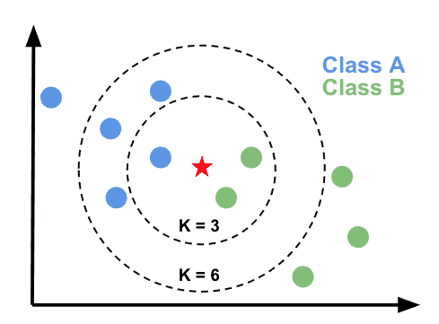
K Nearest Neighbor Models
KNN is a simple, instance-based classification method.
Predicts a transaction's label (fraud or not) based on the 'k' closest examples in the training set.
Requires feature scaling because it relies on distance calculations.
Works well on small to medium datasets but can be slow on very large datasets.
Measures the distance between a new point and all training data points.
Selects the k nearest neighbors and assigns the most common class.
Majority class (non-fraud) overwhelms minority class (fraud).
Without adjustments, KNN tends to predict "not fraud" almost all the time.
Small values of k capture local patterns but are sensitive to noise whereas large values of k oversimplify and can miss frauds

Slide 14
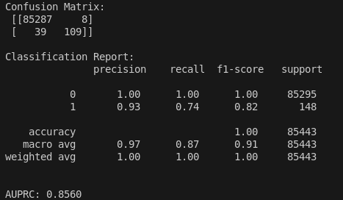
Basic K Nearest Neighbor
Trained a K-Nearest Neighbors (KNN) model with k = 5 neighbors.
No hyperparameter tuning was performed, k value was selected manually.
Used full training data without sampling.
Evaluation Metrics: Classification Report, AUPRC.
Strengths:
High precision (few false fraud predictions).
Very low number of false positives.
Limitations:
Fixed k might not be the best choice for this dataset.
Could miss opportunities to improve fraud detection performance.

Slide 15
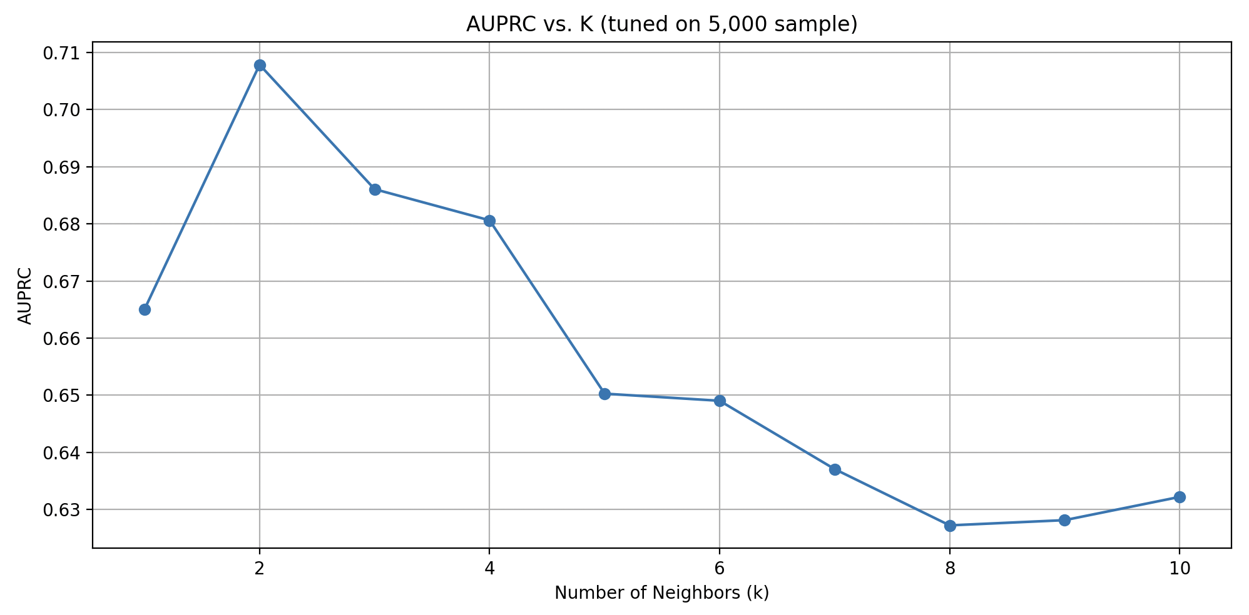
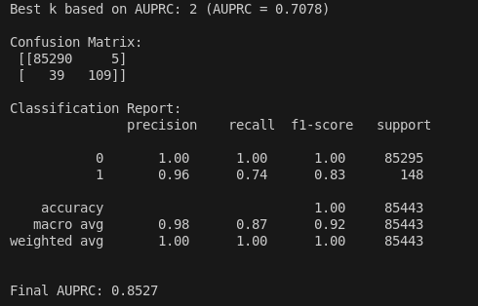
Tuned K Nearest Neighbor
Performed tuning by testing k values from 1 to 10.
Used a small sample (5,000 transactions) for quicker tuning while maintaining class balance.
Evaluated each k using AUPRC (Area Under the Precision-Recall Curve) to focus on fraud detection performance.
Selected the best k automatically based on the highest AUPRC score.
Retrained the final KNN model on the full training set using the optimal k.
k = 2 achieved the highest AUPRC (0.7078) during tuning, indicating the best balance between precision and recall.
A lower k captures local fraud patterns more effectively without being overwhelmed by the majority class.
Higher k values diluted performance, leading to lower recall and reduced AUPRC. k = 2 provided the strongest overall fraud detection for this dataset.

Slide 16
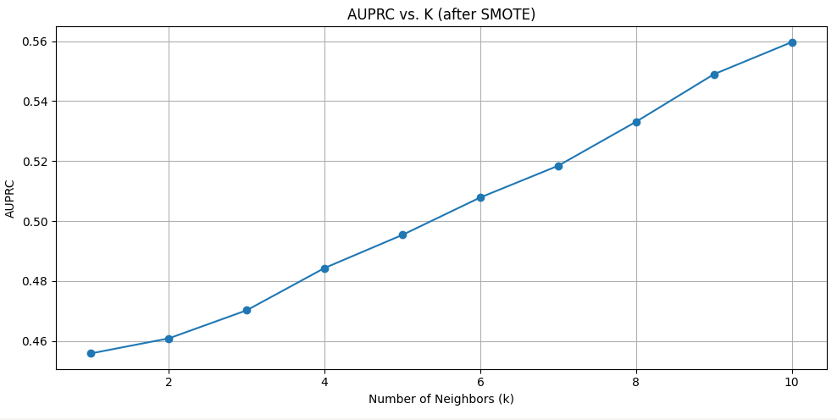
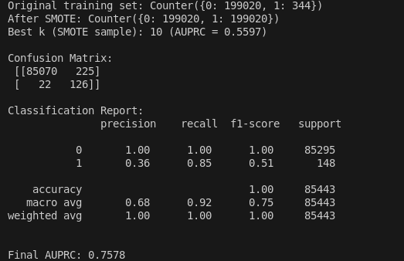
K Nearest Neighbor with SMOTE Analysis (Synthetic Minority Oversampling Technique)
Applied SMOTE to balance the training data by generating synthetic fraud samples.
Performed k tuning (testing k=1 to 10) on a small sample.
Selected k = 10 based on highest AUPRC after SMOTE.
k=10 after SMOTE is expected, because balancing the dataset with synthetic frauds makes the data more uniform, requiring more neighbors to make reliable predictions.
k=10 being best is expected: SMOTE creates dense fraud clusters, so larger k values are better for stable predictions.
SMOTE improved fraud detection (recall) but hurt precision by introducing synthetic noise.
SMOTE is helpful when catching all frauds is more important than avoiding false positives.

Slide 17
KNN Final Summary
Basic KNN (k=5):
Strong precision (0.93) and solid recall (0.74); AUPRC = 0.8560.
Good performance without tuning, but not optimized.
Tuned KNN (best k=2):
Highest precision (0.96) and balanced recall (0.74); AUPRC = 0.8527.
Best overall model — strongest fraud detection balance.
KNN with SMOTE (best k=10):
Recall improved to 0.85, but precision dropped to 0.36; AUPRC = 0.7578.
Caught more frauds but created many more false positives.
Is KNN Ideal?
Good as a baseline: Simple, interpretable, decent precision after tuning.
Not ideal for large-scale deployment: Slow on large datasets and sensitive to imbalance.
KNN struggles with heavily imbalanced data, because the majority class (proper transactions) overwhelms minority class predictions (fraud).
Balancing techniques like SMOTE are needed to help KNN perform better, but overall, other models are typically more effective for highly skewed datasets.

Slide 18

Comparative Study: EEMD-MMRVFLN+ vs. EMD-RVFLN
Introduction
Hybrid Classification Models
Basic Properties:
W (Input weights)
b (Biases)
beta (Output weights)
n_hidden (Number of hidden neurons)
X is input feature
EMD: Traditional signal decomposition and shallow random feature learning.
Challenges: ▪ Mode mixing in EMD. ▪ Limited feature abstraction
Motivation: ▪ Improve decomposition reliability ▪ Enhance model depth and feature fusion.

Slide 19
Comparison of Both Models
Methodology Overview
Methodology Overview
Content:
EMD: Empirical Mode Decomposition for stable IMFs extraction.
RVFLN: Single layer Random vector functional Link Network
RVFLN+: ▪ Random Vector Functional Link Network.
Dynamic Threshold Optimisation for classification.
Methodology Overview
Content:
EEMD: Ensemble Empirical Mode Decomposition for stable IMF extraction.
RVFLN: Single layer Random vector functional Link Network
MMRVFLN+: ▪ Multi-hidden-layer Random Vector Functional Link Network. ▪ Multi-kernel learning at each layer.
Dynamic Threshold Optimisation for classification.

Slide 20
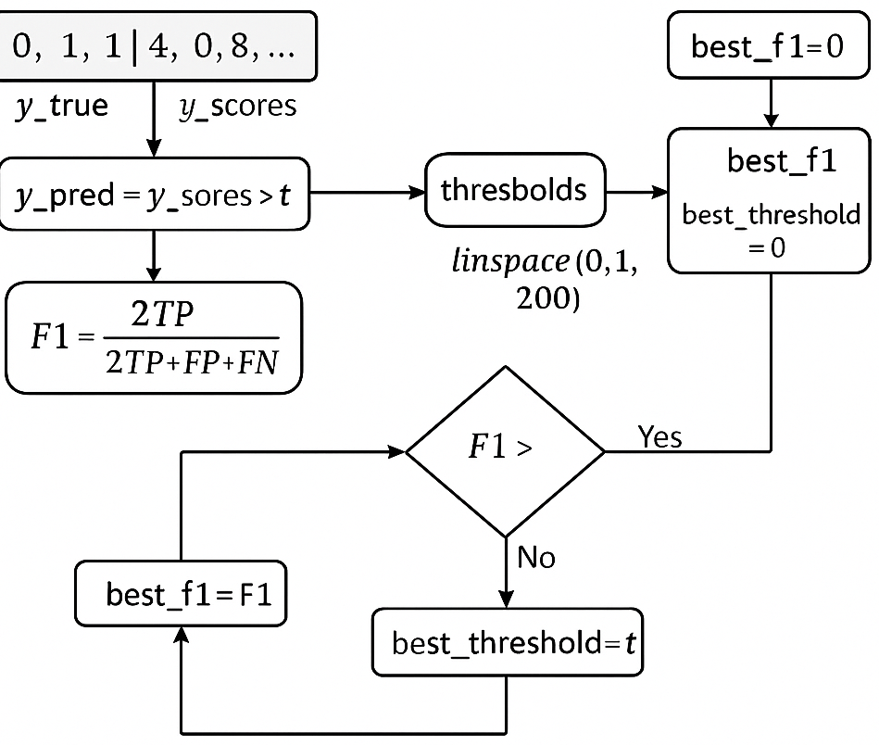
Model-I
Traditional EMD-RVFLN
Content:
EMD applied to raw signal.
Single-layer RVFLN model:
Random input projections.
Output weight learning.
Fixed threshold (0.2) for classification.

Slide 21
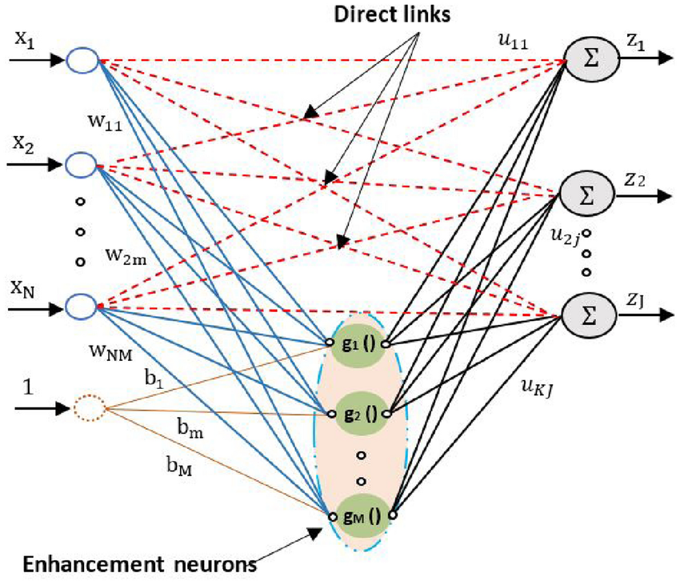
Proposed
EEMD-MMRVFLN+ Model
Content:
EEMD decomposes the signal into stable IMFs.
Multi-layer feature stacking:
Deepening feature abstraction.
Multi-kernel mappings for diverse feature spaces.
Threshold-optimised post-training.

Slide 22
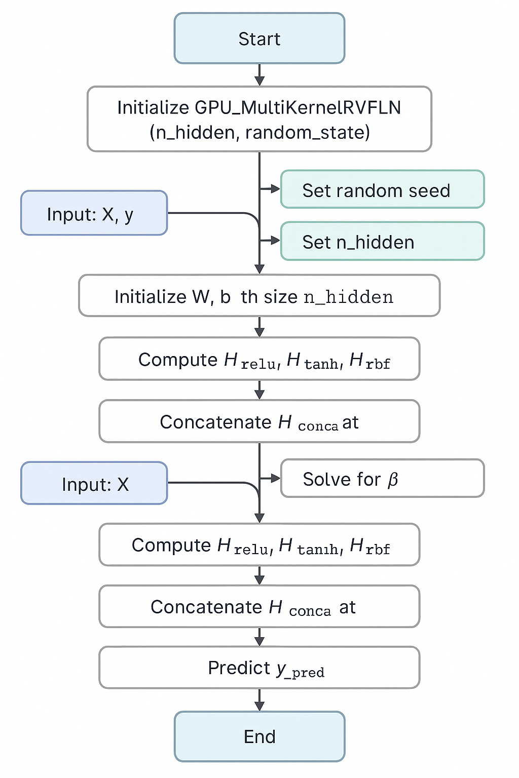
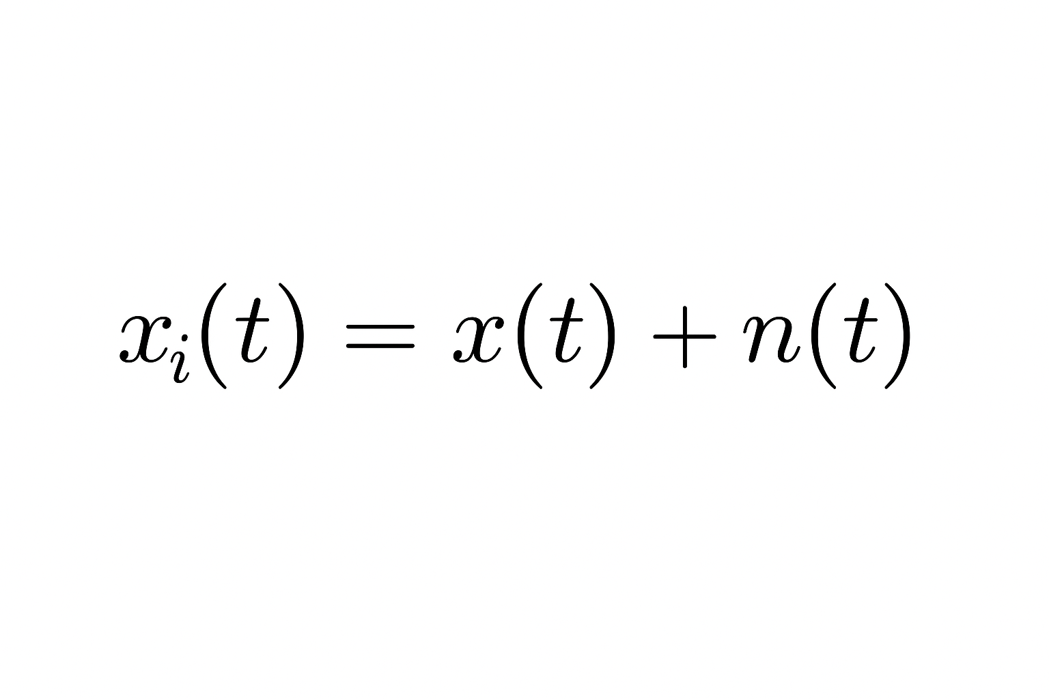
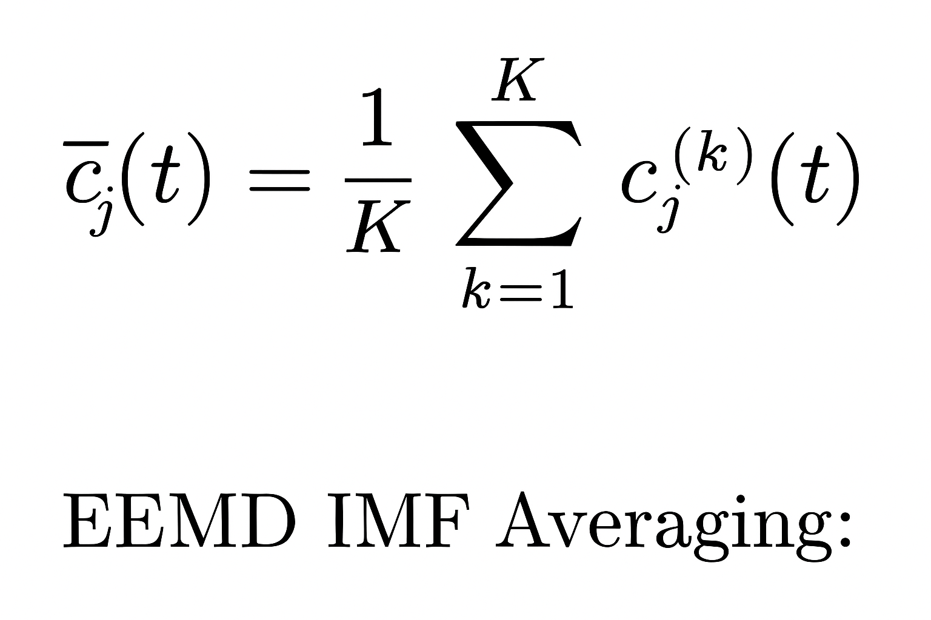
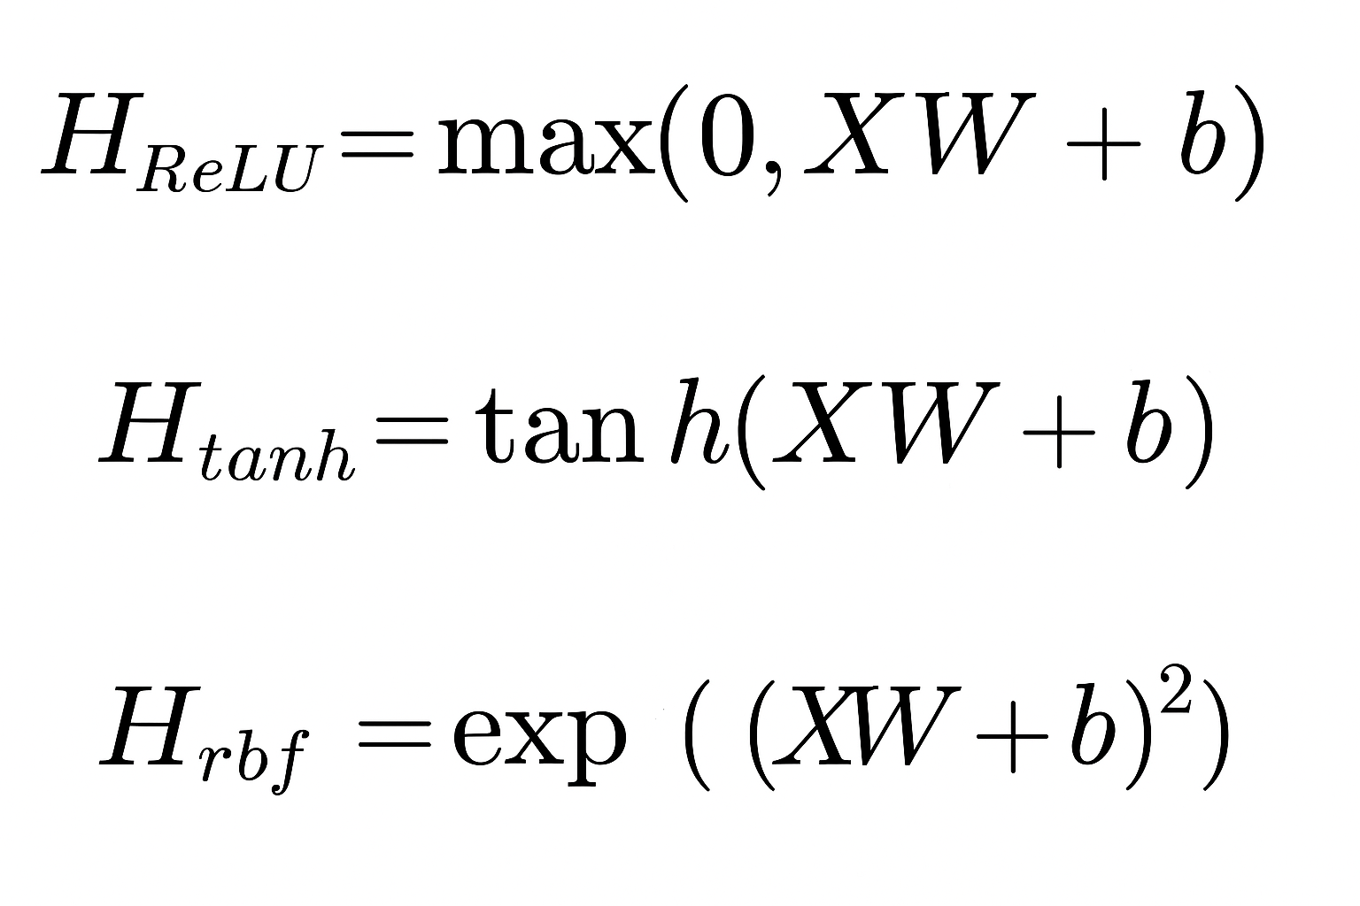
Architecture Details
Noise addition
Single Layer RVFLN
Multi Layer RVFLN+

Slide 23
DEMONSTRATE THE MODEL
Input: X (input data), y (target labels)
Output: Model with trained parameters (W, b, beta)
1. Get number of samples and features from X
2. Initialize:
W ← random normal matrix of shape (n_features, n_hidden)
b ← random normal vector of shape (1, n_hidden)
3. Compute hidden layer outputs:
H_relu ← ReLU( X * W + b )
H_tanh ← tanh( X * W + b )
H_rbf ← exp( - ( X * W + b )^2 )
4. Concatenate hidden outputs:
H_concat ← [H_relu, H_tanh, H_rbf]
5. Regularization term:
reg ← small constant (e.g., 1e-3)
6. Solve for output weights (beta):
beta ← (H_concatᵀ * H_concat + reg * I)^(-1) * H_concatᵀ * y

Slide 24
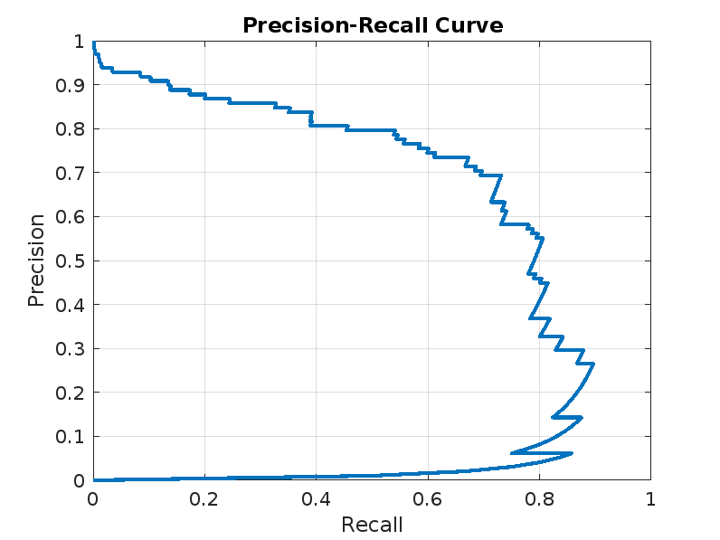
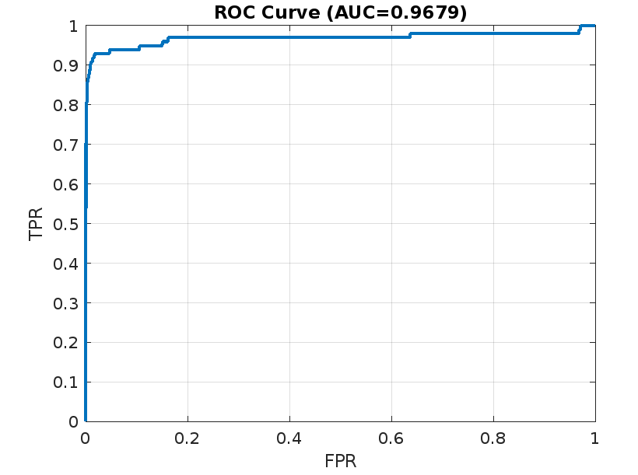
RESULTS
Simulation Results

Slide 25
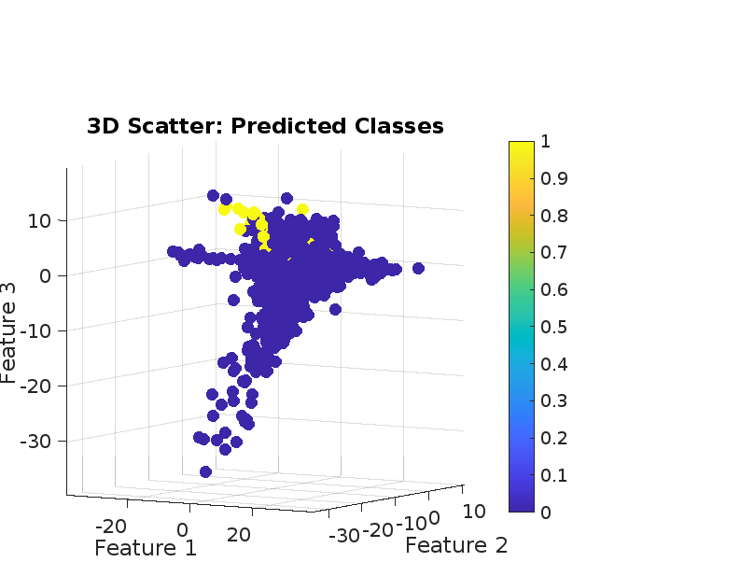
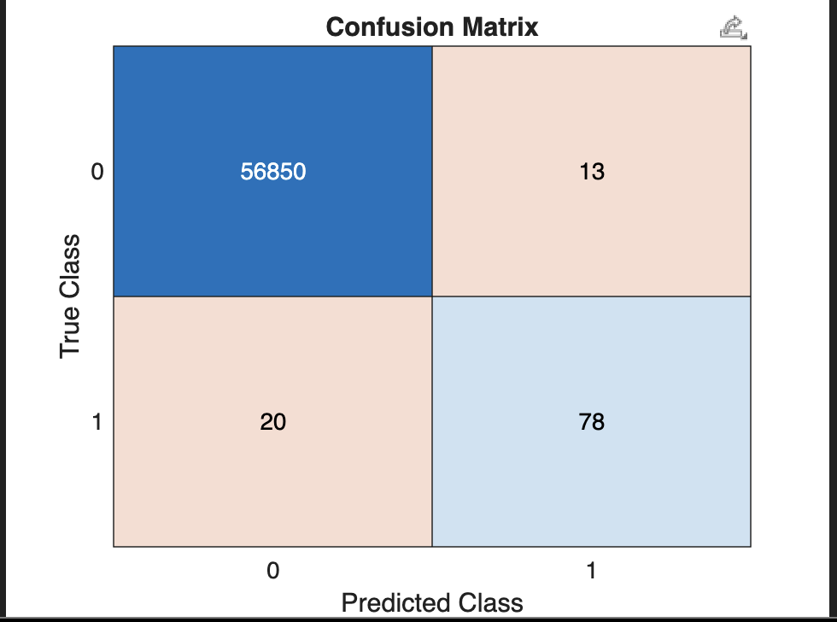
Experimental Results
Higher accuracy and F1 score observed.
ROC and PR curves show superior performance.
Confusion matrices indicate improved classification balance.

Slide 26
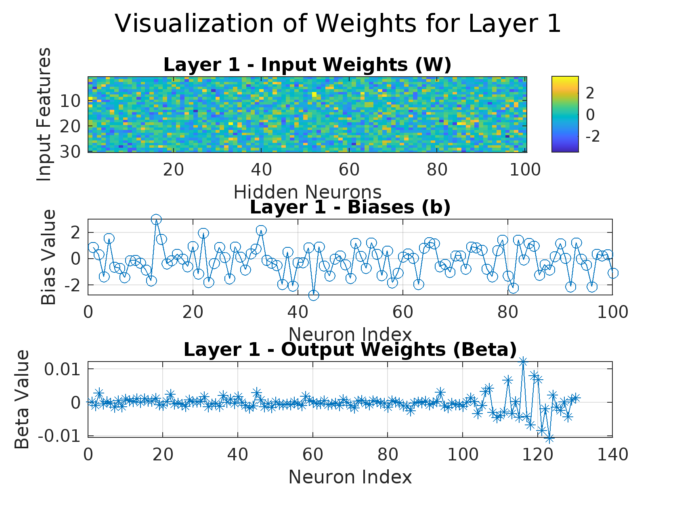
Why EEMD-MMRVFLN+ is Better?
Reduced mode mixing with EEMD.
Deeper and richer feature extraction via multi-layers.
Multi-kernel fusion captures complex relationships.
Threshold optimisation improves F1-score.
Better generalisation on imbalanced datasets.

Slide 27
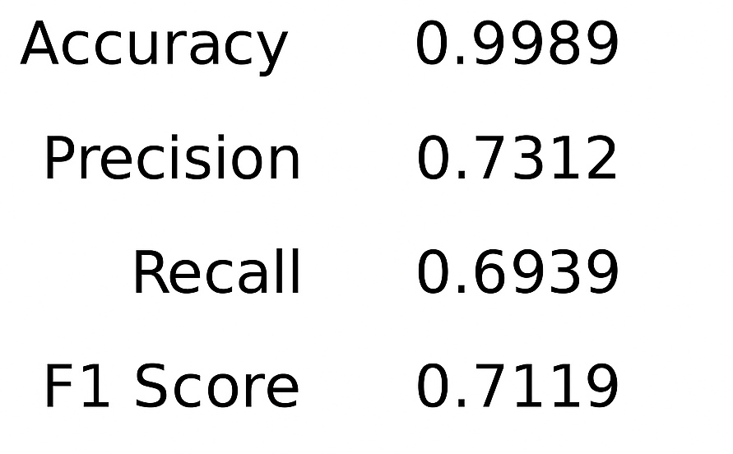
Final Summary
conclusion
EEMD-MMRVFLN+ offers a robust, scalable, and accurate classification framework.
Superior decomposition, learning depth, and thresholding.
Highly recommended for real-world noisy and imbalanced data.

Slide 28



Related Works
By 2027, e-commerce will make up close to a quarter of total global retail sales.
In one survey, 42% of respondents said their organizations are much more vulnerable to an online fraud attack due to digital transformation.
One study revealed that two-thirds of consumers would switch providers due to fraud.
The addition of GenAI to fraud detection algorithms can help companies better protect future transactions against emerging threats than was possible with traditional statistical or machine learning-driven solutions.
Articles:
PayPal. "Payment Fraud Detection: Machine Learning." PayPal, https://www.paypal.com/us/brc/article/payment-fraud-detection-machine-learning.
Cuttler, Elyse. "Inside the algorithm: How gen AI and graph technology are cracking down on card sharks." Mastercard, 18 Jul. 2024, https://www.mastercard.com/news/perspectives/2024/inside-the-algorithm-how-gen-ai-and-graph-technology-are-cracking-down-on-card-sharks/.
Notes:
Niketan

